Slide 1
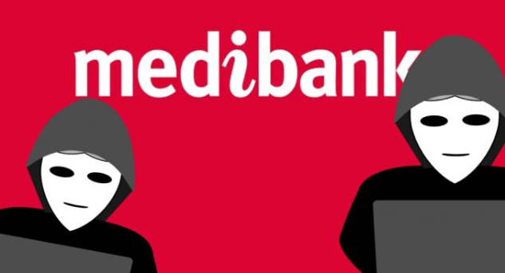
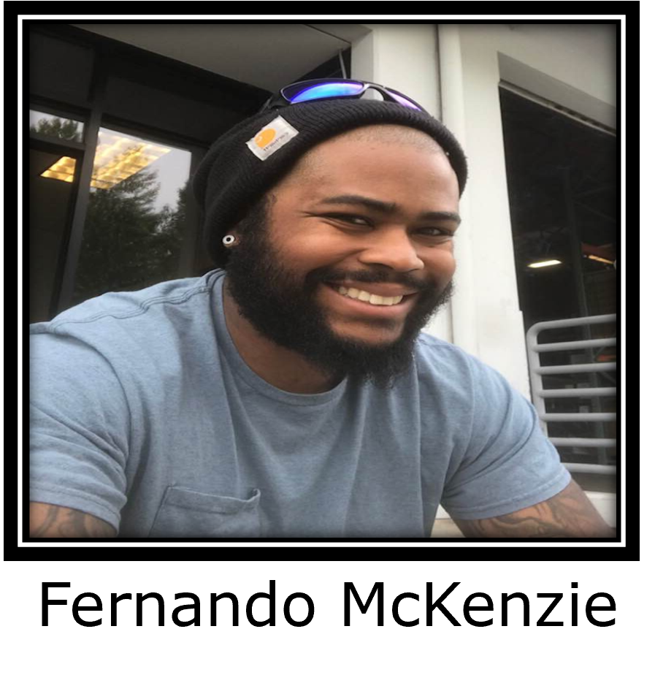
CITYU - STC SCHOOL OF TECHNOLOGY AND COMPUTING
Cybersecurity Club
WELCOME TO Week 5 BREACH OF THE WEEK
Presented by
C I T Y U S T C CYBERCLUB
Notes:
What is hacking? _Short answer
Explanation in lame terms : Hacking refers to unauthorized intrusion in a system or a network. The person involved in this process is called a hacker. They use the computer to commit non-malicious activities such as privacy invasion, stealing personal/corporate data, and more.

Slide 2
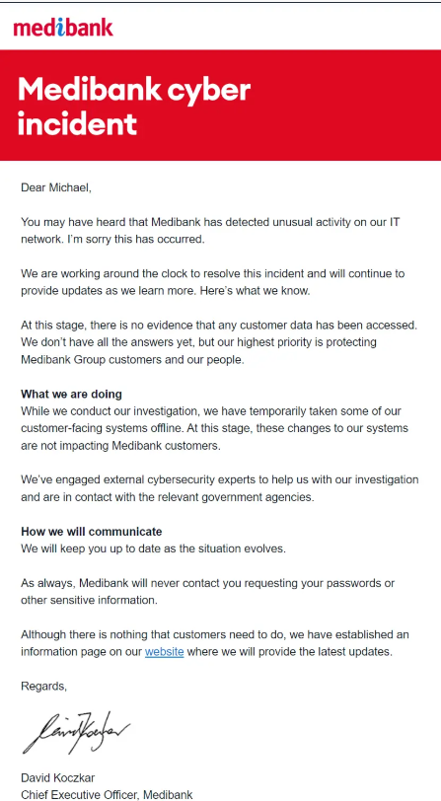
AGENDA
Medibank Attack
Stolen Data
CityU Club Discussion/Recommendations
Cost of Compliance
Ransomware Cost
Event Summary
Q/A
References
C I T Y U S T CYBERCLUB

Slide 3
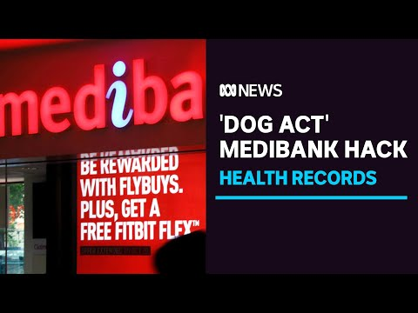
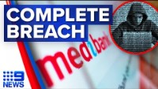
Medibank Acknowledges Data Loss
C I T Y U S T CYBERCLUB
AHM customers’ personal data and significant amounts of health claims data.
International student customers’ personal data and significant amounts of health claim data.
Medibank customers’ personal data and significant amounts of health claim data.

Slide 4


Post video introduction Questions
List the Mentimeter Access code and website on this slide for people to access if they want to

Slide 5
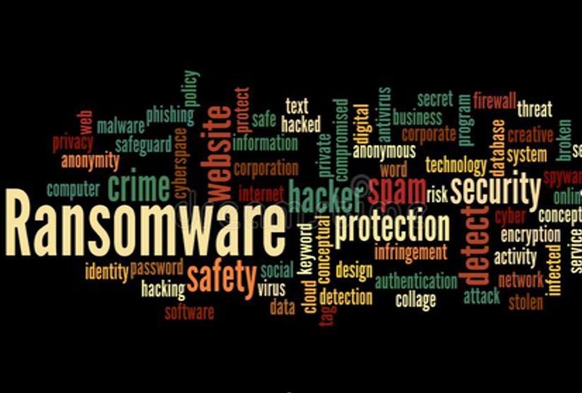
Reaction
The hacker organization claims to have stolen 200 gigs of sensitive information from Medibank and threatens to contact the company's 1000 most notable customers with their own personal information as a warning shot if Medibank does not pay them.
C I T Y U S T CYBERCLUB
At this time, would you please head over to Mentimeter to answer a few questions, the code will be provided on the next slide.

Slide 6
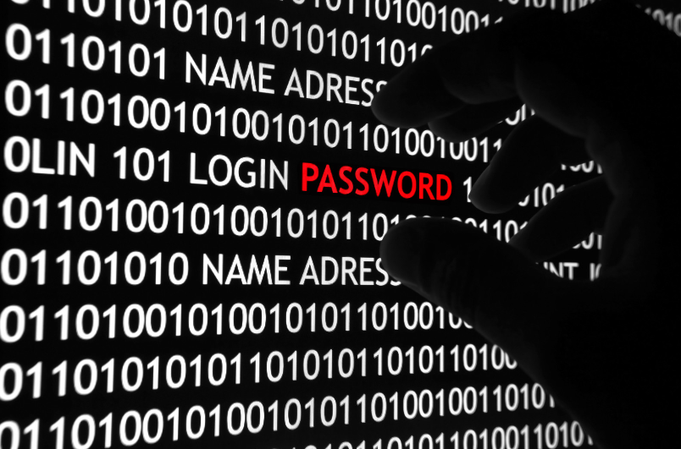
Attack Type: Ransomware
At one of Australia's top private health insurers, cybercriminals gained access to over 3.9 millions of patients' medical details.
Credential Theft: Its unclear how Someone with high-level access to the system had their login credentials stolen by a criminals, who then sold them to another hacker on an online forum in Russian.
The criminal asserts that more information, including data relating to the safety of credit card transactions, was stolen.
C I T Y U S T C CYBERCLUB
Notes:
Its called spear phishing
I don’t know how they do things in australia but they probably did and are auctioning them off

Slide 7
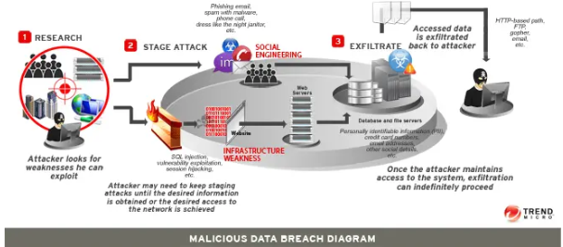
Stolen Data/ Consequences
Key Info Stolen
First names & Last names
Addresses
Dates of Birth
Medicare Numbers
Policy numbers
Data from claims made to the insurers
Hacker Goals
Fullz | Identity Kits
Consequences
These bundles often include "all the intricacies of a person's health history, preferred pharmacy, almost everything."
Gain Fraudulent Id's from the Dark Web
Loans using stolen identities
C I T Y U S T C CYBERCLUB
Notes:
The hackers' ultimate goal is to develop fullz and identity kits, both of which are collections of files. According to Scott, these bundles often include "all the intricacies of a person's health history, preferred pharmacy, almost everything." The thieves will then use this information to order fraudulent identification documents on the dark web or take out loans under the victim's name and social security numbers.

Slide 8
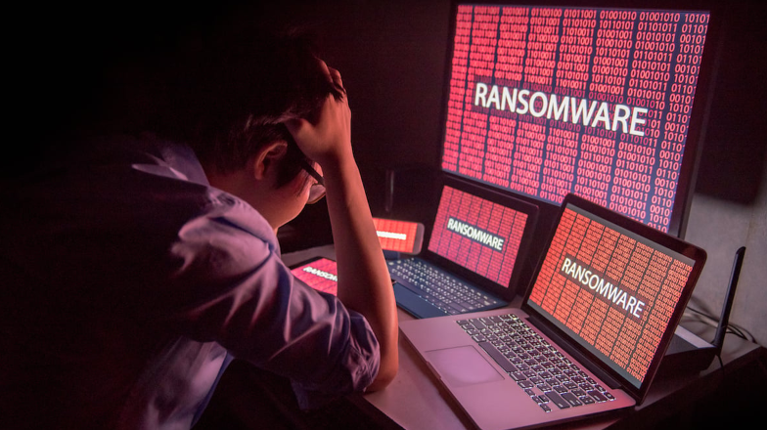
City-U Discussion
Victim: Medibank and its 3.9 million + customers
Australia’s private health insurance providers ( Major HIPAA (Health Insurance Portability and Accountability Act) security violation, I believe the also stole Credit card information Medibank does not store CVC (Card Verification Code) related data I still believe it’s a violation of PCI DSS (Payment Card Industry Data Security Standards))
(We can talk about compliance and audits)
(Hypothetical: CEO_CIO_CTO Mindset) what if you where the CEO of a private health insurance provider (What would you do if your org was attacked?) when it comes to your Cybersecurity Posture, How would you address upcoming challenges? ( enie minie minie mo (pick one)).

Slide 9
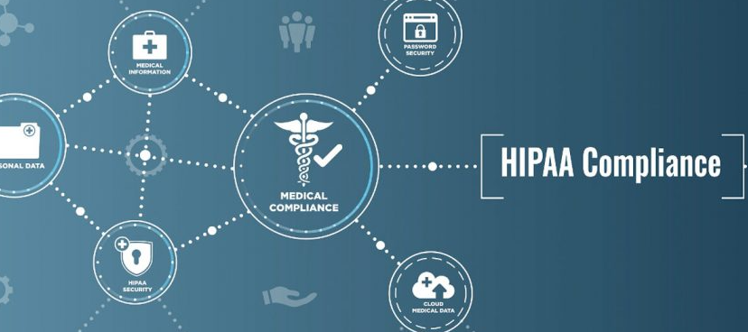
A breach of one's medical records is, as you are aware, an extremely expensive problem to have. The failure of a covered entity to protect patients' health information can result in one of four levels of fines under HIPAA, the severity of which depends on the covered entity's reaction.
First Tier: There is a possible range of penalties, from $100 to $50,000 each offense (up to $1.5 million total). The first level of sanctions is handed out in situations when a covered entity either did not know about a breach or had no way of knowing about it.
Second Tier: These fines can range anywhere from $1,000 to $50,000 (and even up to $1.5 million per offense). In this level, the covered entity either knew about the breach or should have known about it if they had exercised the appropriate level of diligence; nonetheless, this does not qualify as willful neglect.
Third Tier: These penalties, which can total up to $1.5 million per event and range from $10,000 to $50,000, are handed out in cases where a covered business behaved with intentional disregard but repaired the breach within the allotted time frame of 30 days.
Fourth Tier: These fines start at a minimum of $50,000 per event and can go as high as $1.5 million for willful neglect that does not result in any appropriate adjustments being made in a timely manner.
Compliance
C I T Y U S T C CYBERCLUB
Notes:
Organization carries the responsibility, whether there is foul play or not

Slide 10
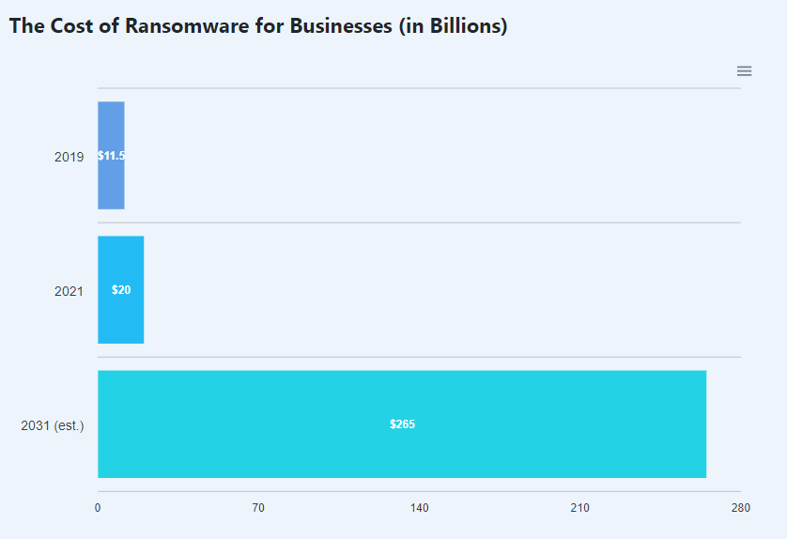
Cost of Ransomware Globally
In the year 2021, ransomware cost the world a total of $20 billion. It is anticipated that by the year 2031, that figure will have increased to $265 billion.
In 2021, ransomware compromised the systems of 37% of all commercial and nonprofit organizations.
The average cost to recover from a ransomware attack for a company in 2021 is expected to be $1.85 million.
32 percent of ransomware victims choose to pay the demanded amount, yet even after doing so, they only recover 65 percent of their data.
Only 57 percent of companies are successful when attempting to retrieve their data by employing a backup.
In the case of Medibank its fines to whichever is greater of $50 million, 30% of the company’s turnover in the relevant period or 3 times the value of any benefit gained from breach.
C I T Y U S T C CYBERCLUB

Slide 11
Summary
On October 12, they discovered odd activity on the company network, which is when they realized that Medibank was the target of an attack. After taking action, Medibank Group began "isolating and removing access to some customer-facing systems in order to decrease the potential of harm to systems or data loss."
The business announced on Monday (October 17) that it has "controlled the ransomware threat" and that ransomware had not encrypted any of its systems. It was confirmed on Wednesday (October 19) that the attackers had contacted the company with accusations that they had stolen data from the company's servers.
The information that the sample records that the attackers presented as evidence of their claim turned out to be legitimate was disclosed by Medibank on Thursday (October 20).
This information consists of first and last names, addresses, dates of birth, Medicare numbers, insurance numbers, phone numbers, and various types of claim data. This claims data comprises the location at where a client obtained medical services, as well as codes referring to the customer's diagnosis and procedures, as noted by the
researchers.
There are about 4 million consumers using Medibank's services, but it's probable that the data of some of their past customers was also exposed.
C I T Y U S T C CYBERCLUB

Slide 12
Reference
Eliaçık, E., & Gülen, K. (2022, October 20). Medibank Cyber Attack: Medibank Private Hack explained. Dataconomy. Retrieved October 30, 2022, from https://dataconomy.com/2022/10/medibank-cyber-attack-medibank-private-hack/
Gross, J. A., Sharon, J., Blum, M., Horovitz, M., Obel, A., staff, T. O. I., Magid, J., staff, A. F. P. and T. O. I., JEANTET, M. S. A. V. A. R. E. S. E. and D. I. A. N. E., Gilban, M. M., Fabian, E., Jr., D. E. N. N. I. S. W. A. S. Z. A. K., Agencies, T. O. I. staff and, AFP, T. O. I. staff and, Ghert-Zand, R., Magid, J., Mukand, J., Keller-Lynn, C., Mandel, J., … Schwartz, P. (2022, October 26). Australia admits cyber defenses 'inadequate' as medical records of millions hacked. The Times of Israel. Retrieved October 30, 2022, from https://www.timesofisrael.com/australia-admits-cyber-defenses-inadequate-as-medical-records-of-millions-hacked/
Gsimon. (2021, August 16). What are the consequences of a medical record breach. American Retrieval Company. Retrieved October 30, 2022, from https://americanretrieval.com/medical-records-breach/
Kochovski, A. (2022, March 22). Ransomware statistics, trends and facts for 2022 and beyond. Cloudwards. Retrieved October 30, 2022, from https://www.cloudwards.net/ransomware-statistics/
Zorz, Z. (2022, October 25). Medibank hack turned into a data breach: The attackers are demanding money. Help Net Security. Retrieved October 30, 2022, from https://www.helpnetsecurity.com/2022/10/21/medibank-hack-data-breach/#:~:text=The%20attack%20on%20Medibank%20was,to%20systems%20or%20data%20loss.%E2%80%9D

